Slide 1

User Experience and User Interface Design
5 - Android UI Design Introduction - ViewGroups.pptx
Dr. Seyed Reza Shahamiri More Info

Slide 2
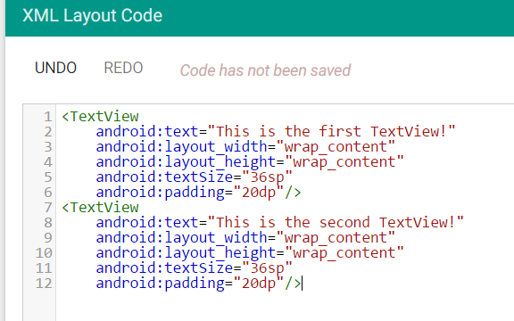

Background
2
Try to add two TextViews:

Slide 3
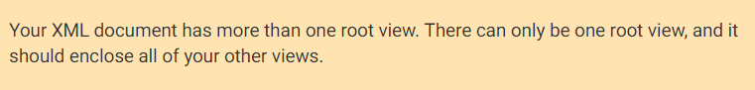
Background
3
Adding two TextViews causes an error:
In order to use several views, you need to put them inside a GroupView.
The GroupView will then be the single view, and all other views will be inside it.

Slide 4
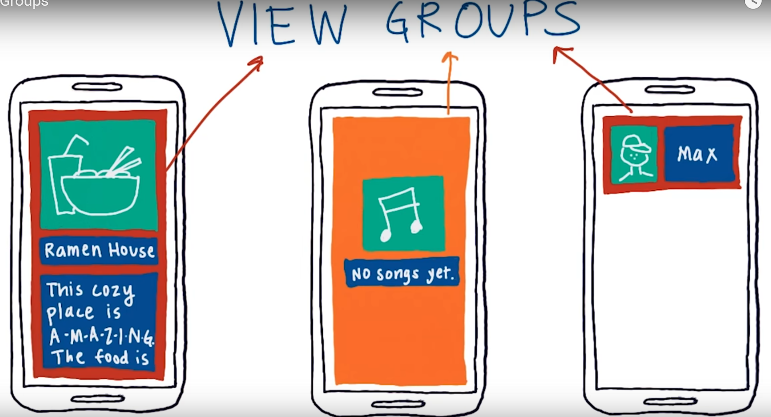
ViewGroups
4
A ViewGropu is a view that its content is other views. It is a container of other views.
It has its own attributes like background color, width, height, etc.

Slide 5
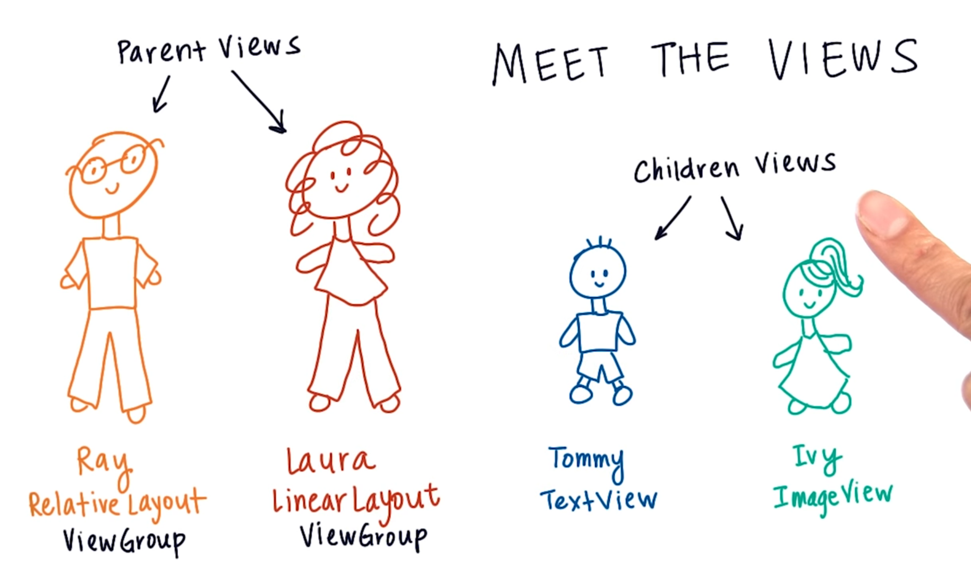
ViewGroups Parent/Child Views
5

Slide 6
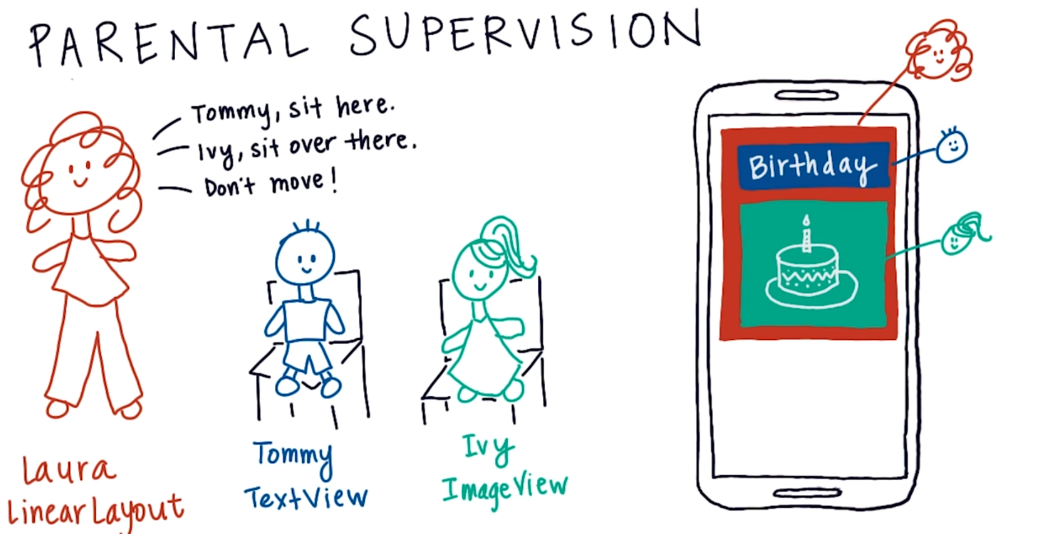
ViewGroups Parent/Child Views
6
Parent views (i.e. GroupViews) can decide where the child views are located and arranged.

Slide 7
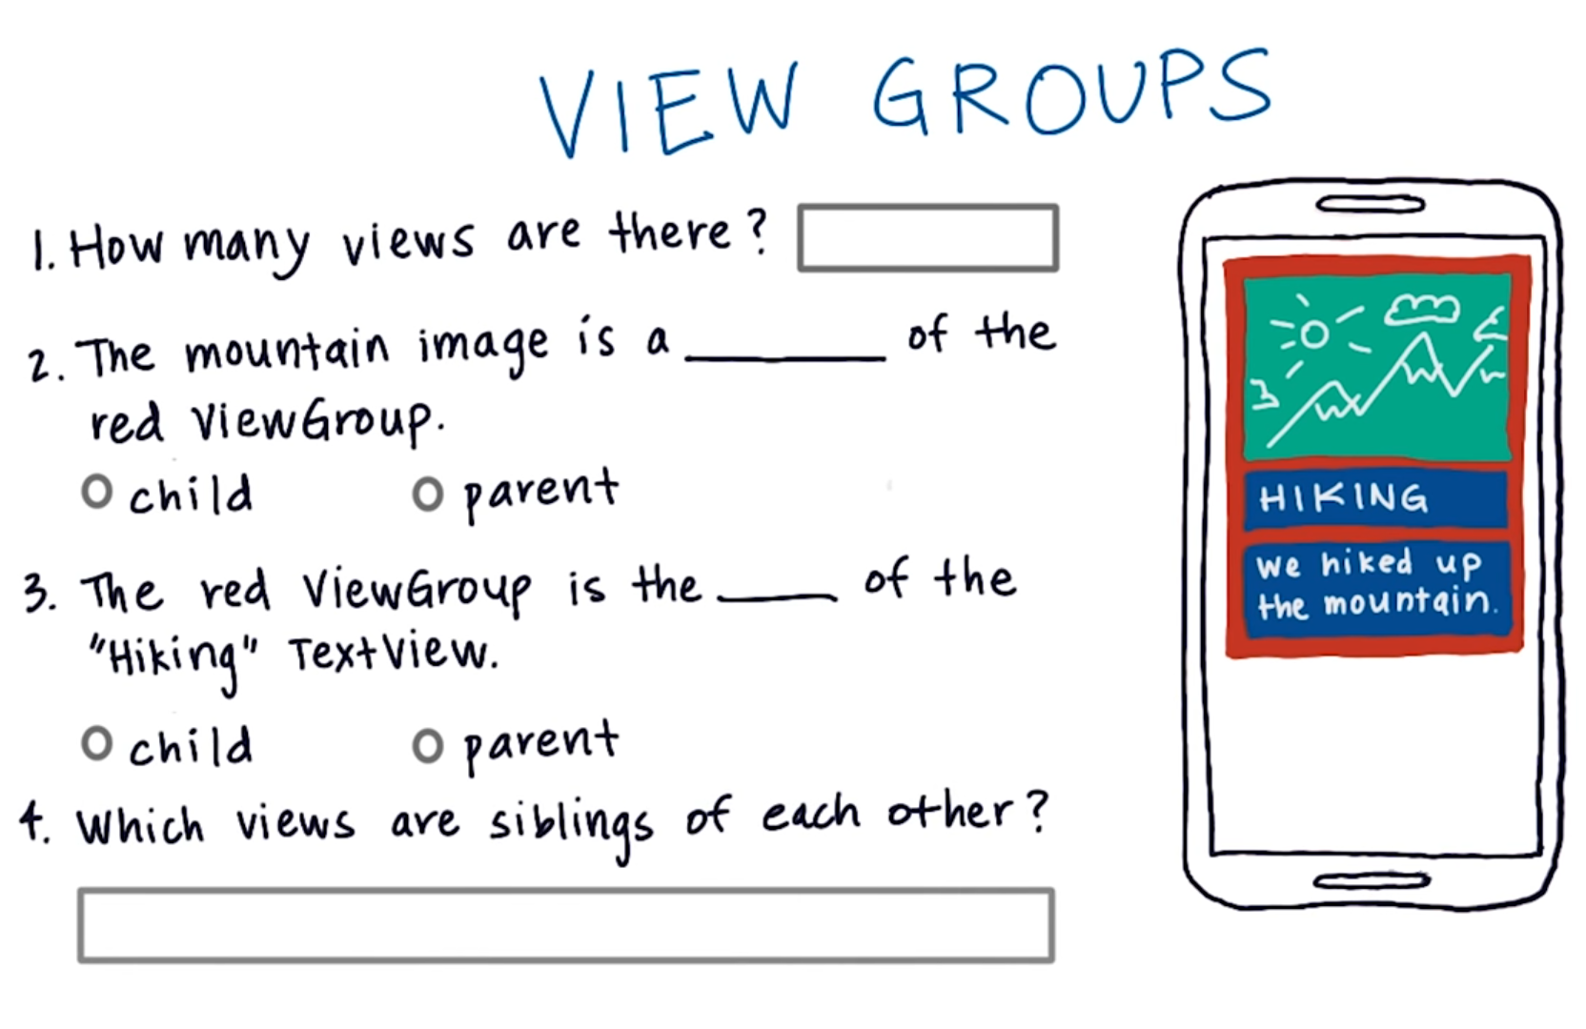
ViewGroups Parent/Child Views Exercise
7

Slide 8
ViewGroups Types
8
Here we discuss three different types of ViewGroups each one positioned their child views differently:
LinearLayout
RelativeLayout
ScrollView

Slide 9
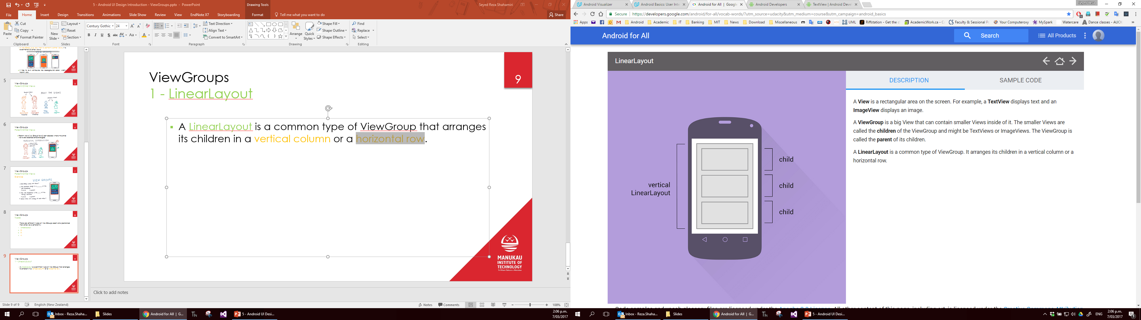
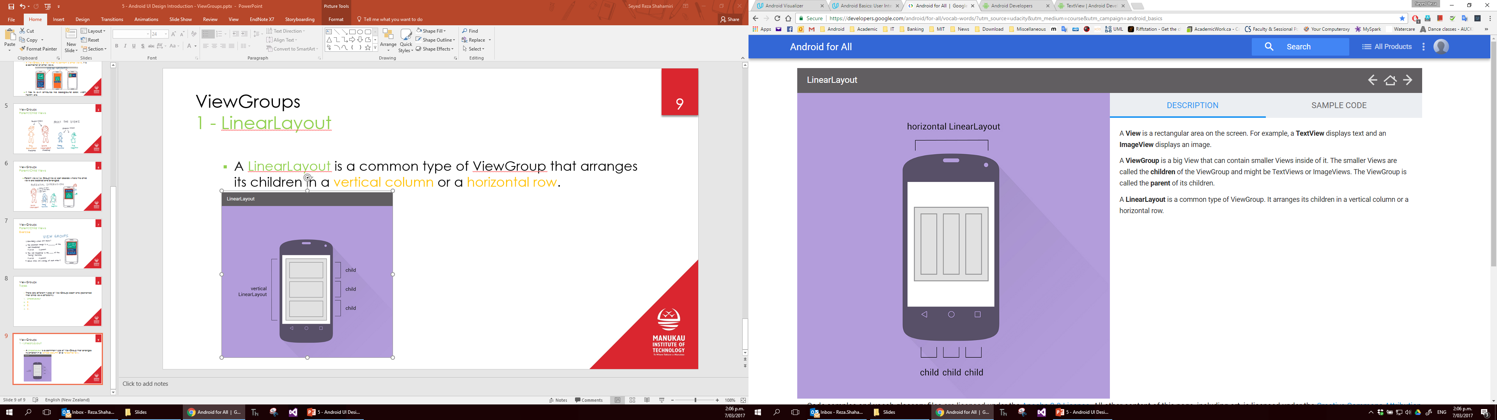
ViewGroups 1 - LinearLayout
9
A LinearLayout is a common type of ViewGroup that arranges its children in a vertical column or a horizontal row.

Slide 10
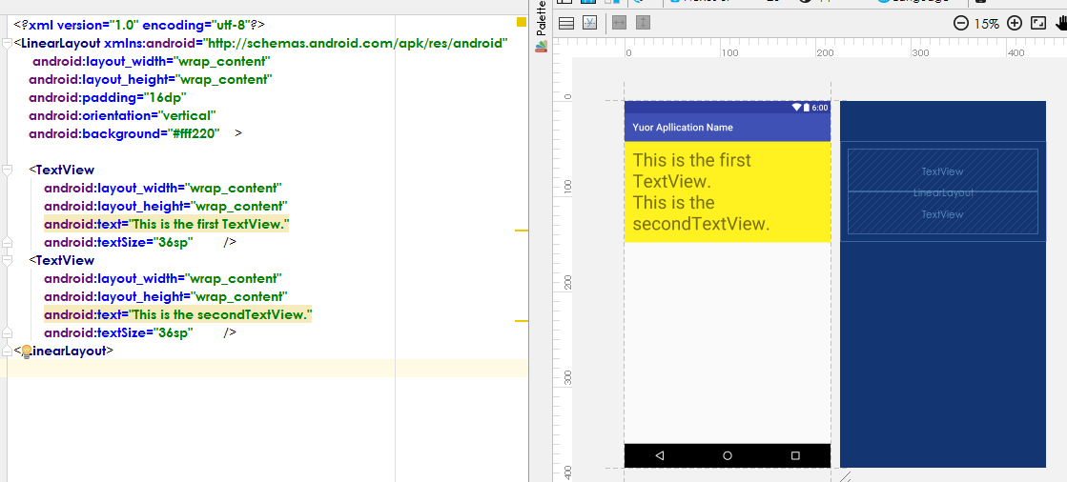
ViewGroups 1 - LinearLayout
10

Slide 11
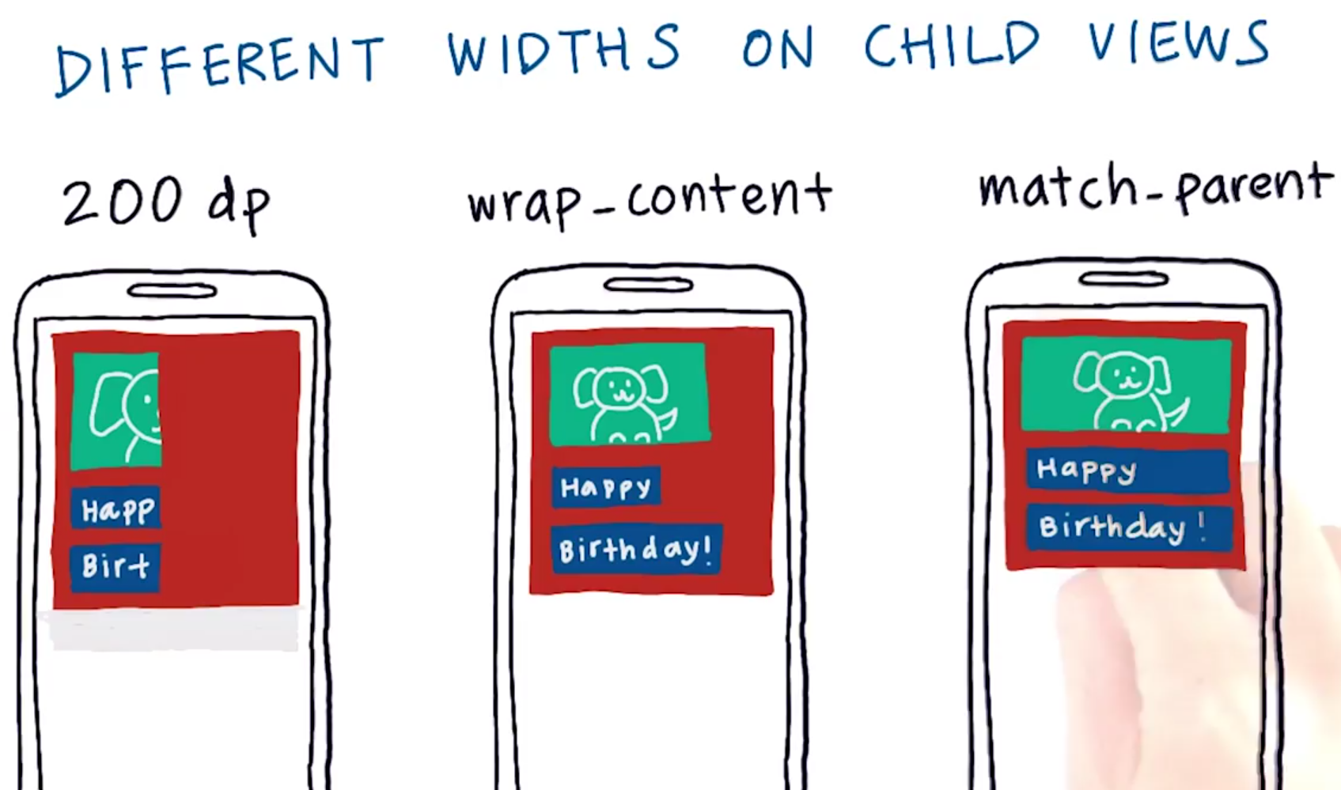
ViewGroups 1 – LinearLayout View Widths Options
11

Slide 12
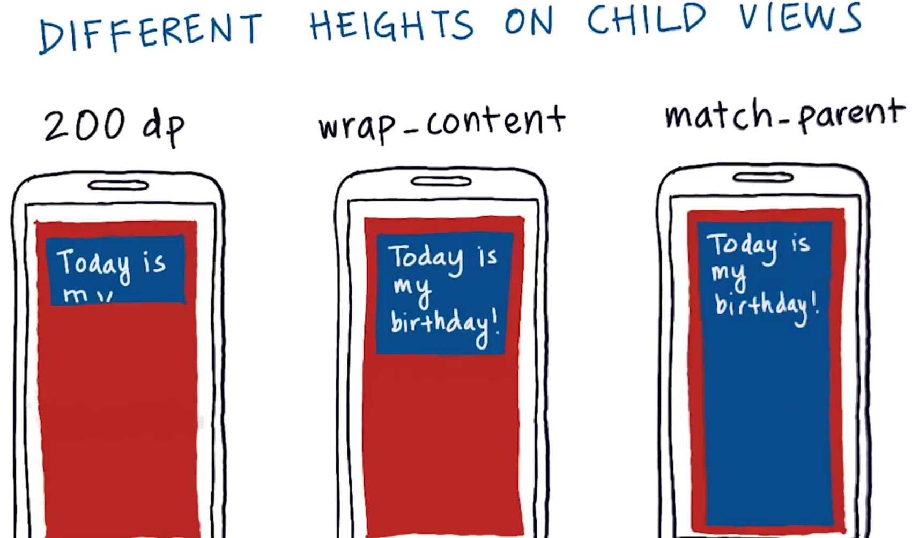
ViewGroups 1 – LinearLayout View Heights Options
12

Slide 13
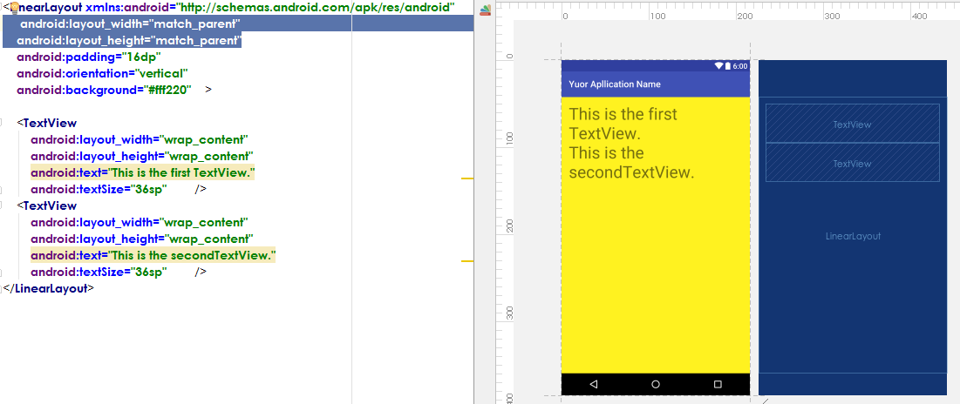
ViewGroups 1 - LinearLayout
13
Setting width and/or height attributes to match_parent causes the view to fill all of the available space given to it by its parent.

Slide 14
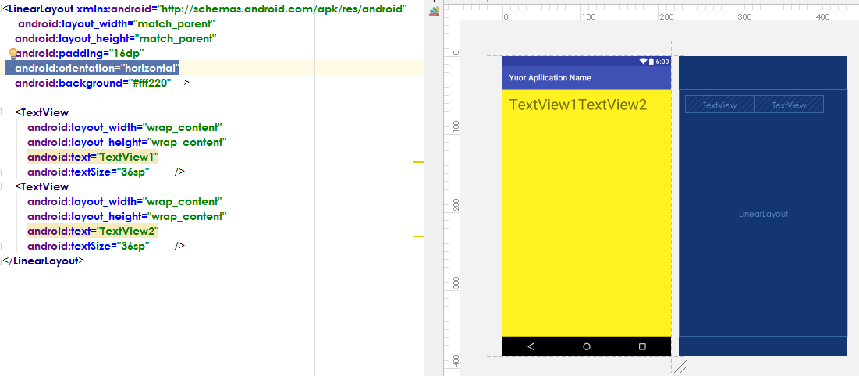
ViewGroups 1 - LinearLayout
14

Slide 15
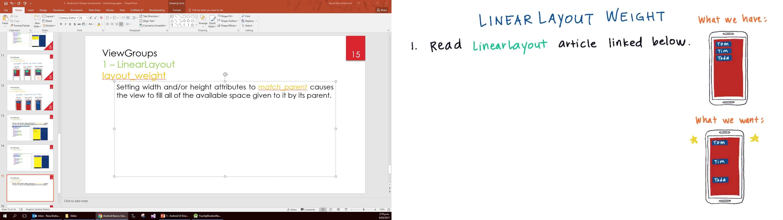
ViewGroups 1 – LinearLayout layout_weight
15

Slide 16
ViewGroups 1 – LinearLayout layout_weight
16
In order to spread out views evenly in LinearLayout, layout_weight attribute of the child views can be used.
If you want to distribute the views evenly vertically:
For each child view, set the height property to 0dp
For each child view, set the layout_weight attribute to 1

Slide 17
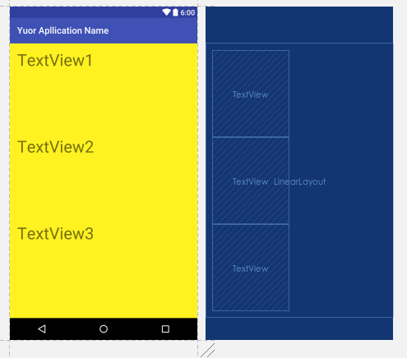
ViewGroups 1 – LinearLayout layout_weight
17
<LinearLayout xmlns:android="http://schemas.android.com/apk/res/android" android:layout_width="match_parent" android:layout_height="match_parent" android:background="#fff220" android:orientation="vertical" android:padding="16dp"> <TextView android:layout_width="wrap_content" android:layout_height="0dp" android:layout_weight="1" android:text="TextView1" android:textSize="36sp" /> <TextView android:layout_width="wrap_content" android:layout_height="0dp" android:layout_weight="1" android:text="TextView2" android:textSize="36sp" /> <TextView android:layout_width="wrap_content" android:layout_height="0dp" android:layout_weight="1" android:text="TextView3" android:textSize="36sp" /> </LinearLayout>

Slide 18
ViewGroups 1 – LinearLayout layout_weight
18
In order to spread out views evenly in LinearLayout, layout_weight attribute of the child views can be used.
If you want to distribute the views evenly horizentally:
For each child view, set the width property to 0dp
For each child view, set the layout_weight attribute to 1

Slide 19
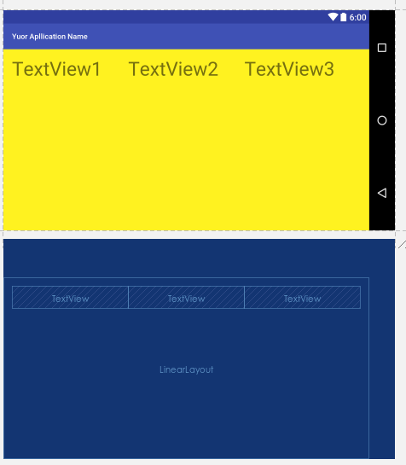
ViewGroups 1 – LinearLayout layout_weight
19
<LinearLayout xmlns:android="http://schemas.android.com/apk/res/android" android:layout_width="match_parent" android:layout_height="match_parent" android:background="#fff220" android:orientation="horizontal" android:padding="16dp"> <TextView android:layout_width="0dp" android:layout_height="wrap_content" android:layout_weight="1" android:text="TextView1" android:textSize="36sp" /> <TextView android:layout_width="0dp" android:layout_height="wrap_content" android:layout_weight="1" android:text="TextView2" android:textSize="36sp" /> <TextView android:layout_width="0dp" android:layout_height="wrap_content" android:layout_weight="1" android:text="TextView3" android:textSize="36sp" /> </LinearLayout>

Slide 20
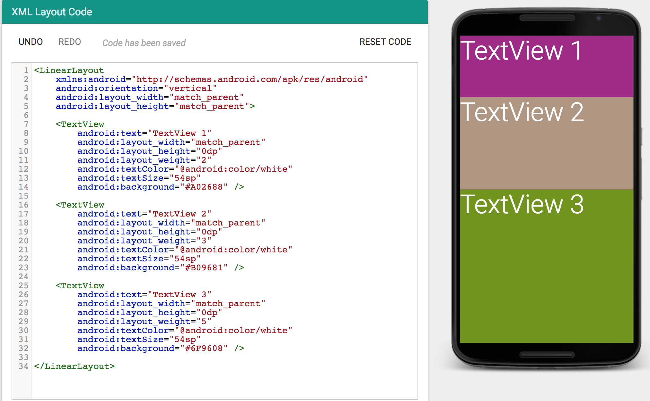
Increasing layout_weight value gives more space to the view.
20

Slide 21
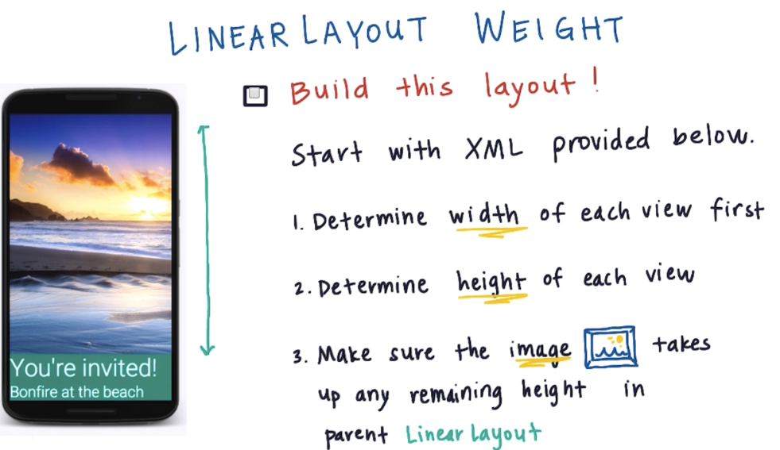
ViewGroups 1 – LinearLayout Exercise
21
Link to the XML

Slide 22
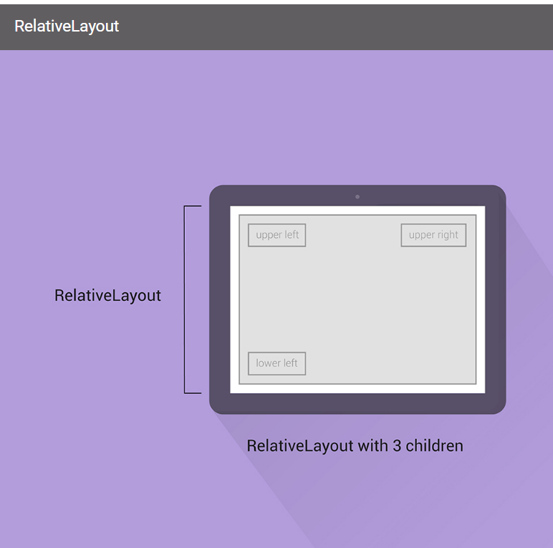
ViewGroups 2 - RelativeLayout
22
A RelativeLayout is a common type of ViewGroup that lets us position its children relative to its own edges.
For example, the three children in the illustration are placed in the corners of a RelativeLayout.
A RelativeLayout also lets us arrange its children relative to each other: one child can be placed to the right/left/up/down of another, and can even overlap.

Slide 23
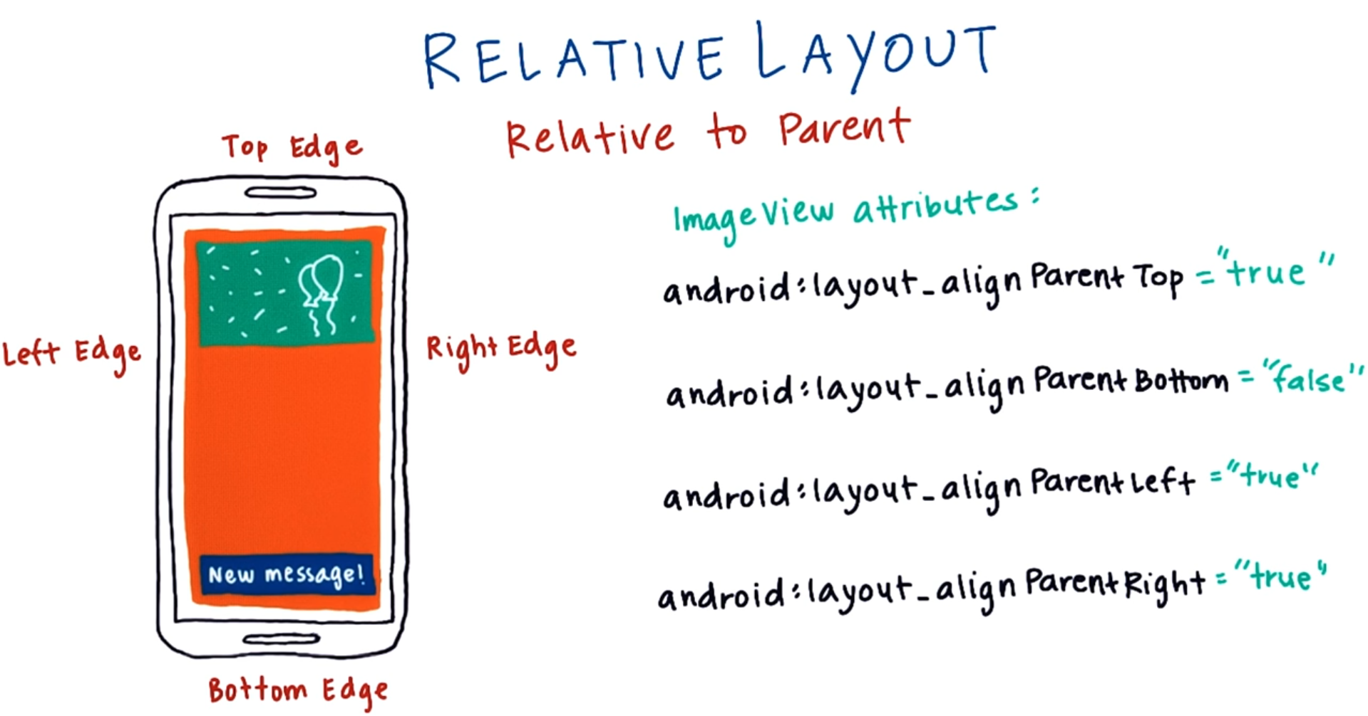
ViewGroups 2 – RelativeLayout Layout Parameters
23

Slide 24
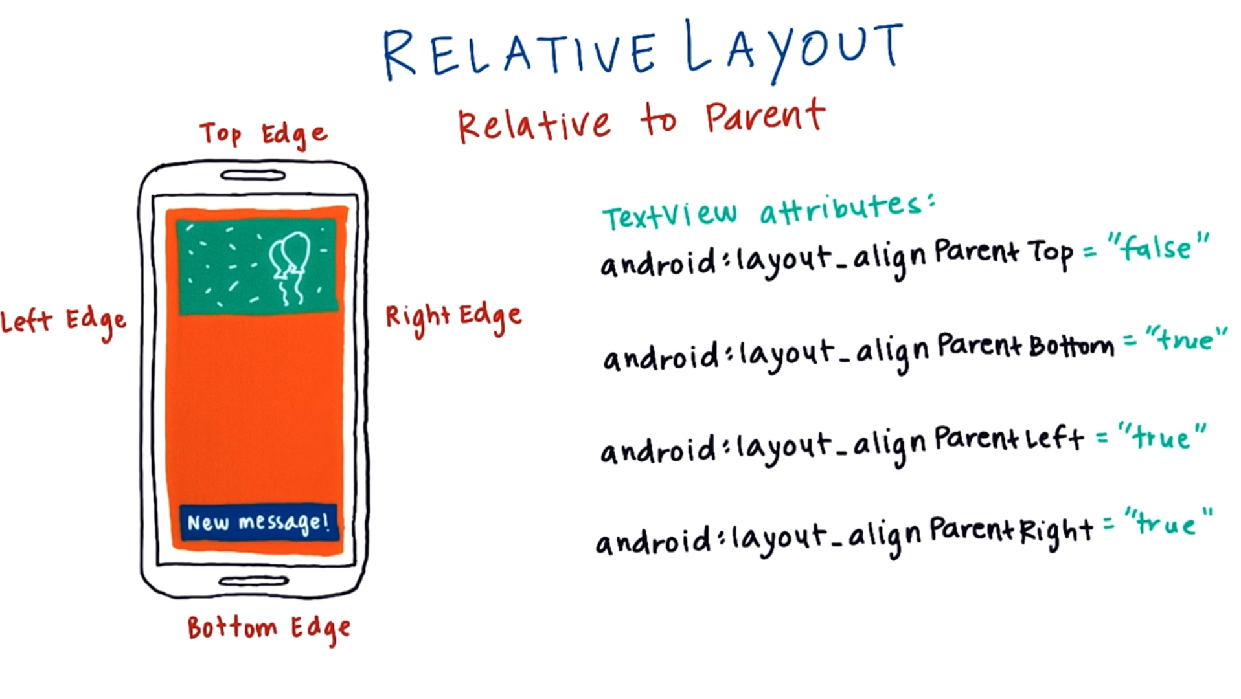
ViewGroups 2 – RelativeLayout Layout Parameters
24

Slide 25
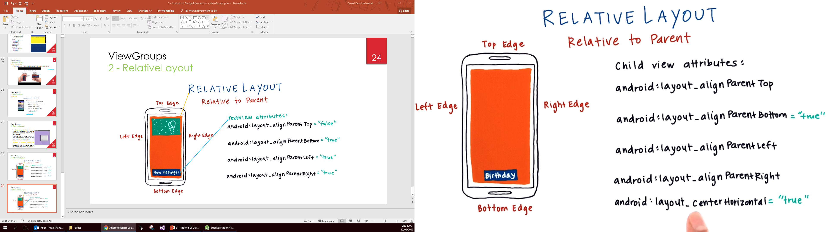
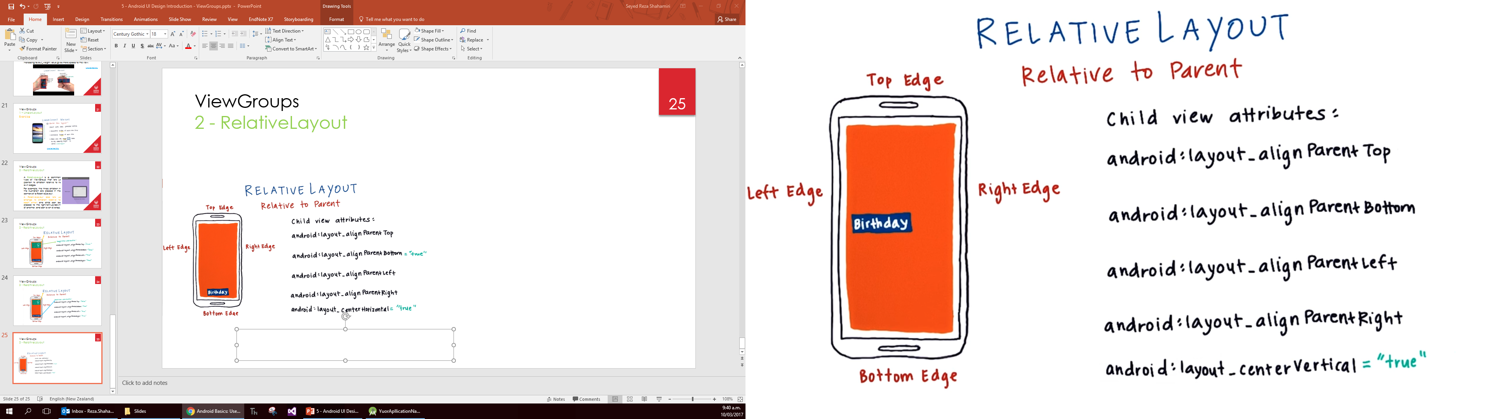
ViewGroups 2 – RelativeLayout Layout Parameters
25
Note: the default value of the above attributes is false so there is no need to mention them.

Slide 26
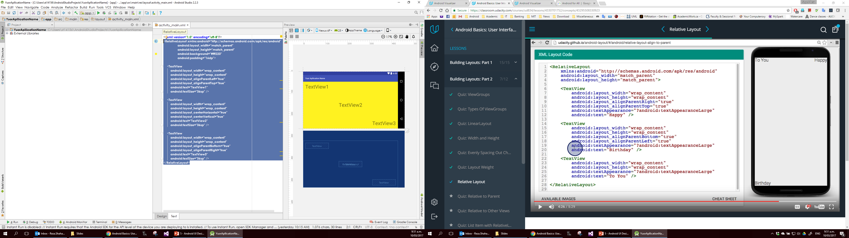
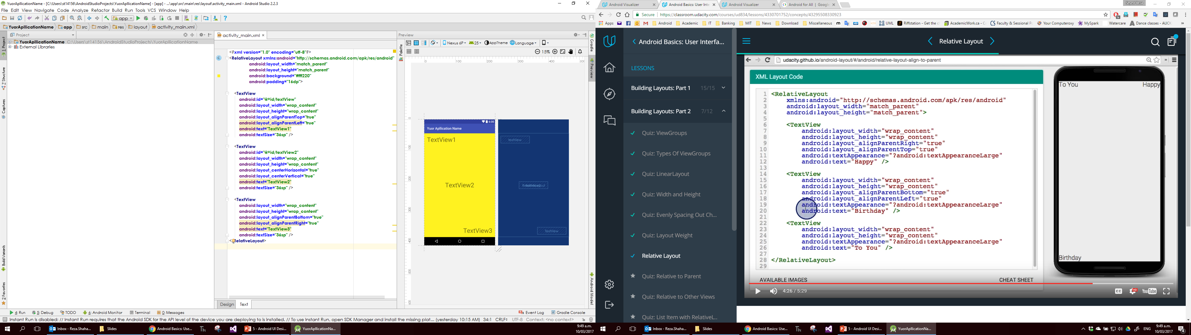
ViewGroups 2 – RelativeLayout Layout Parameters
26
<RelativeLayout xmlns:android="http://schemas.android.com/apk/res/android" android:layout_width="match_parent" android:layout_height="match_parent" android:background="#fff220" android:padding="16dp"> <TextView android:layout_width="wrap_content" android:layout_height="wrap_content" android:layout_alignParentLeft="true" android:layout_alignParentTop="true" android:text="TextView1" android:textSize="36sp" /> <TextView android:layout_width="wrap_content" android:layout_height="wrap_content" android:layout_centerHorizontal="true" android:layout_centerVertical="true" android:text="TextView2" android:textSize="36sp" /> <TextView android:layout_width="wrap_content" android:layout_height="wrap_content" android:layout_alignParentBottom="true" android:layout_alignParentRight="true" android:text="TextView3" android:textSize="36sp" /> </RelativeLayout>

Slide 27
ViewGroups 2 – RelativeLayout Exercise
27
<RelativeLayout xmlns:android="http://schemas.android.com/apk/res/android" android:layout_width="match_parent" android:layout_height="match_parent" android:padding="16dp"> <TextView android:text="I’m in this corner" android:layout_height="wrap_content" android:layout_width="wrap_content" android:layout_alignParentBottom="true" android:layout_alignParentLeft="true" /> <TextView android:text="No, up here" android:layout_height="wrap_content" android:layout_width="wrap_content" android:layout_alignParentTop="true" android:layout_alignParentLeft="true" /> <TextView android:text="Wait, I’m here" android:layout_height="wrap_content" android:layout_width="wrap_content" android:layout_alignParentBottom="true" android:layout_alignParentRight="true" /> <TextView android:text="Actually, I’m here" android:layout_height="wrap_content" android:layout_width="wrap_content" android:layout_alignParentTop="true" android:layout_alignParentRight="true" /> </RelativeLayout>
Whiteout copying the code in any android compiler, try to identify the location of each textview.

Slide 28
ViewGroups 2 – RelativeLayout
28
Children of LinearLayout can be positioned relative to each other as well.
In order to do so, first we need to give the child views unique IDs by setting the following attribute of the child view:
where “a_unique_id” (all lowercase) will be the ID of the view.
Note: ID cannot have “-” character but “_” is fine.
This ID can also be used to refer to the view in the backend Java code in order to read or update the view attributes.
android:id="@+id/a_unique_id"

Slide 29
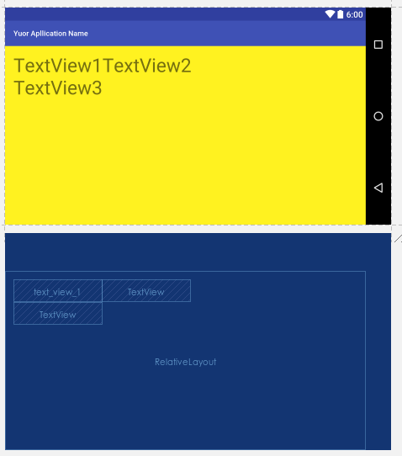
ViewGroups 2 – RelativeLayout
29
<RelativeLayout xmlns:android="http://schemas.android.com/apk/res/android" android:layout_width="match_parent" android:layout_height="match_parent" android:background="#fff220" android:padding="16dp"> <TextView android:id="@+id/text_view_1" android:layout_width="wrap_content" android:layout_height="wrap_content" android:layout_alignParentLeft="true" android:layout_alignParentTop="true" android:text="TextView1" android:textSize="36sp" /> <TextView android:layout_width="wrap_content" android:layout_height="wrap_content" android:layout_toRightOf="@id/text_view_1" android:text="TextView2" android:textSize="36sp" /> <TextView android:layout_width="wrap_content" android:layout_height="wrap_content" android:layout_below="@id/text_view_1" android:text="TextView3" android:textSize="36sp" /> </RelativeLayout>
Next, child views can set layout attributes to be sitting left/right/top/below of another child view with an ID.

Slide 30
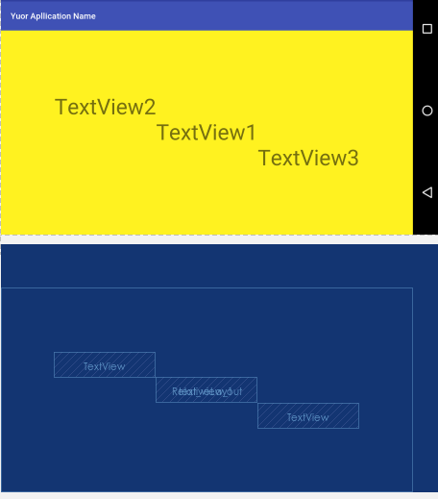
ViewGroups 2 – RelativeLayout
30
<RelativeLayout xmlns:android="http://schemas.android.com/apk/res/android" android:layout_width="match_parent" android:layout_height="match_parent" android:background="#fff220" android:padding="16dp"> <TextView android:id="@+id/text_view_1" android:layout_width="wrap_content" android:layout_height="wrap_content" android:layout_centerHorizontal="true" android:layout_centerVertical="true" android:text="TextView1" android:textSize="36sp" /> <TextView android:layout_width="wrap_content" android:layout_height="wrap_content" android:layout_above="@id/text_view_1" android:layout_toLeftOf="@id/text_view_1" android:text="TextView2" android:textSize="36sp" /> <TextView android:layout_width="wrap_content" android:layout_height="wrap_content" android:layout_below="@id/text_view_1" android:layout_toRightOf="@id/text_view_1" android:text="TextView3" android:textSize="36sp" /> </RelativeLayout>

Slide 31

ViewGroups 2 – RelativeLayout
31
<RelativeLayout xmlns:android="http://schemas.android.com/apk/res/android" android:layout_width="match_parent" android:layout_height="match_parent" android:background="#fff220" android:padding="16dp"> <TextView android:id="@+id/text_view_1" android:layout_width="wrap_content" android:layout_height="wrap_content" android:layout_toLeftOf="@id/text_view_2" android:layout_alignParentBottom="true" android:text="TextView1" android:textSize="36sp" /> <TextView android:id="@+id/text_view_2" android:layout_width="wrap_content" android:layout_height="wrap_content" android:layout_alignParentBottom="true" android:layout_alignParentEnd="true" android:text="TextView2" android:textSize="36sp" /> <TextView android:layout_width="wrap_content" android:layout_height="wrap_content" android:layout_above="@id/text_view_2" android:layout_alignParentEnd="true" android:text="TextView3" android:textSize="36sp" /> </RelativeLayout>

Slide 32
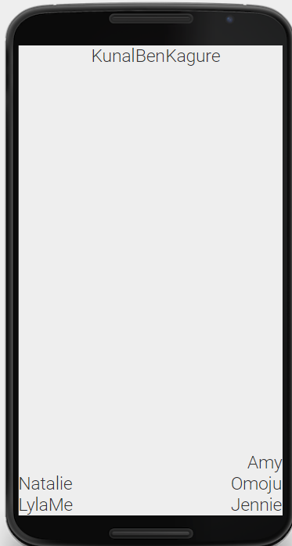
ViewGroups 2 – RelativeLayout Exercise
32
Follow the link below and modify the XML to achieve the following UI:
Link to XML
Note: link to layout attributes and parameters

Slide 33
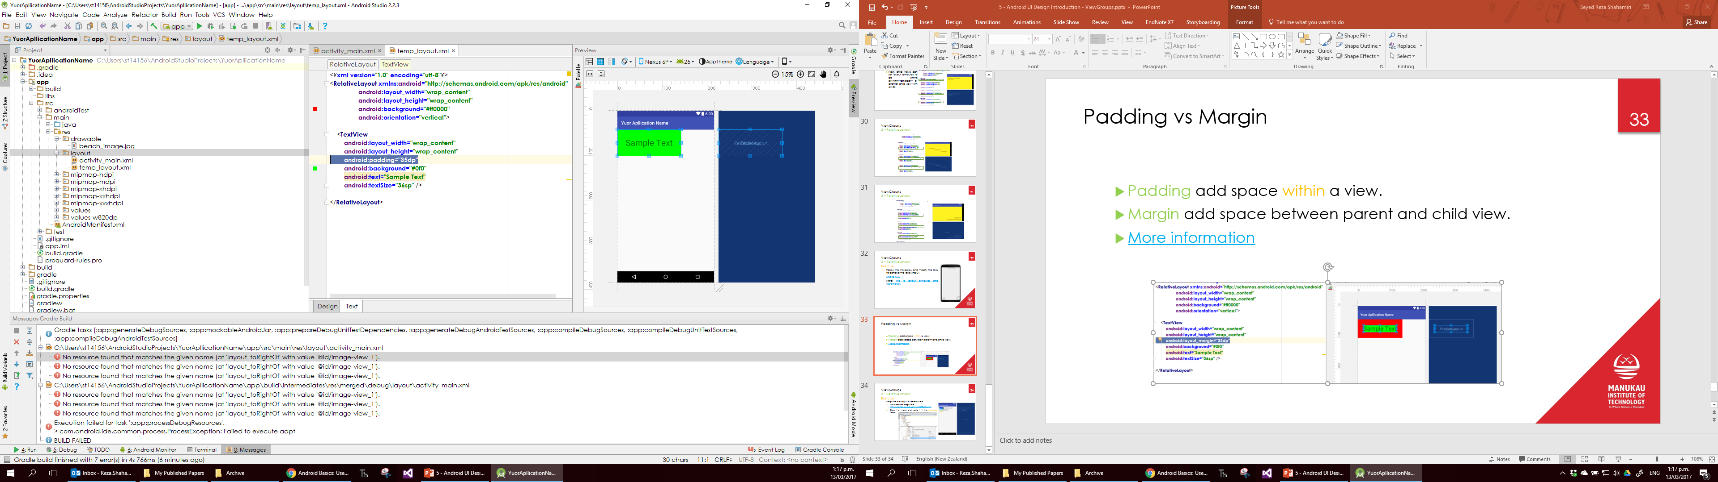
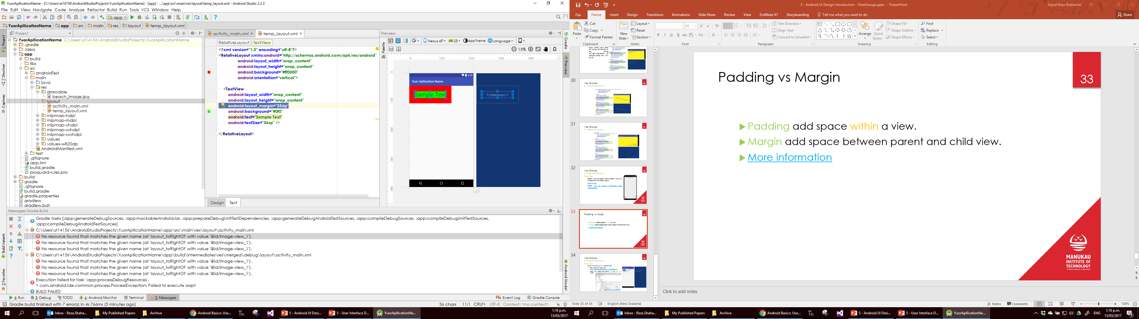
Padding vs Margin
33
Padding add space within a view.
Margin add space between parent and child view.
More information

Slide 34
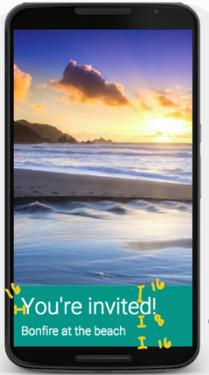
ViewGroups 2 – RelativeLayout Exercise
34
Modify the following XML to achieve the following UI:
Link to the XML

Slide 35
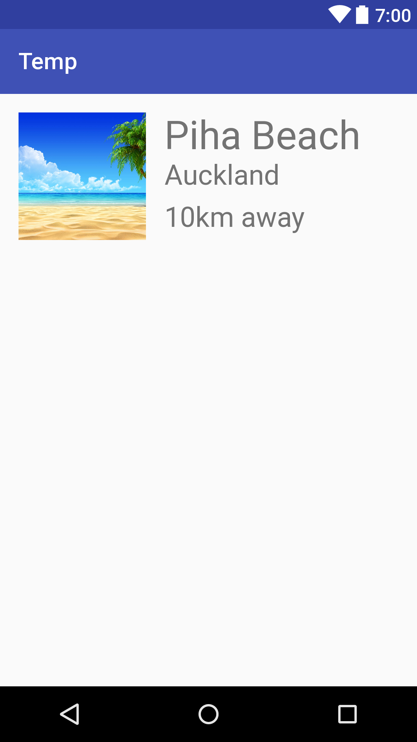
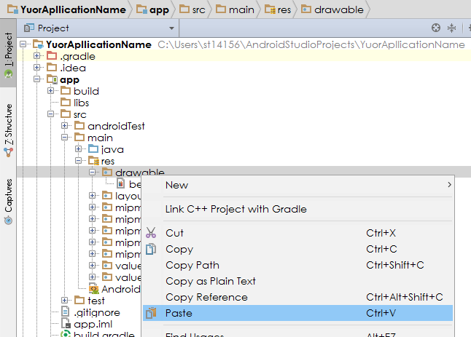
ViewGroups 2 – RelativeLayout Exercise
35
Design the following UI in Android Studio:
Download the image from http://wallpapercave.com/wp/Q7RdkPa.jpg
Copy the image and paste it in the drawable folder:

Slide 36

36
Link

